Slide 1
AIRFRAME TEAM N-2 WEEK3 PRESENTATION
BY
VIVIAN MWANGI
&
MARK ODHIAMBO

Slide 2
PURCHASE OF MATERIALS
WE MANAGED TO MAKE PURCHASE OF THE MATERIALS REQUIRED FOR THE FABRICATION OF THE ROCKET PARTS USING FIBREGLASS AS THE FINAL AIRFRAMEMATERIAL:

Slide 3
CAD DESIGN
WE DID CAD DESIGN FOR THE BODY TUBES
WE 3D PRINTED THE BODYTUBES IN PROTOTYPING LAB 1
AN ASSEMBLY OF THE PARTS WAS DONE

Slide 4
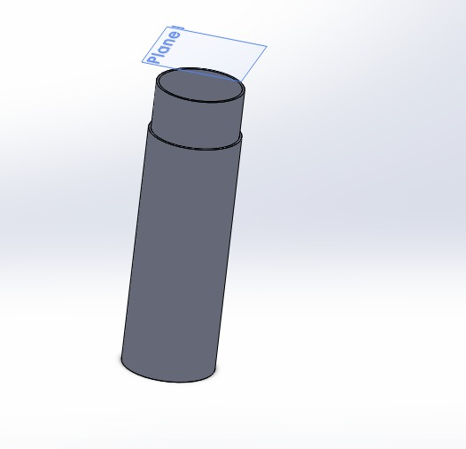
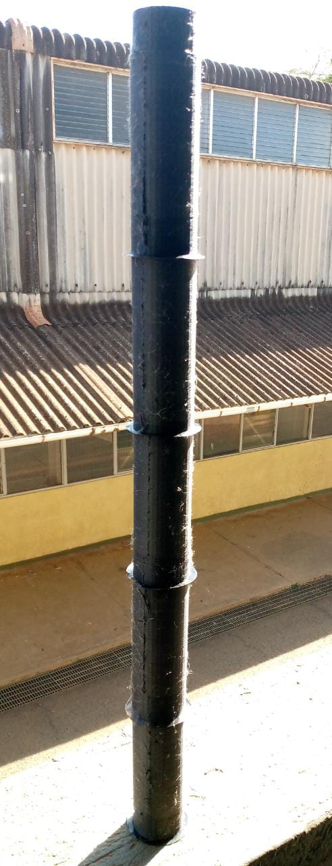
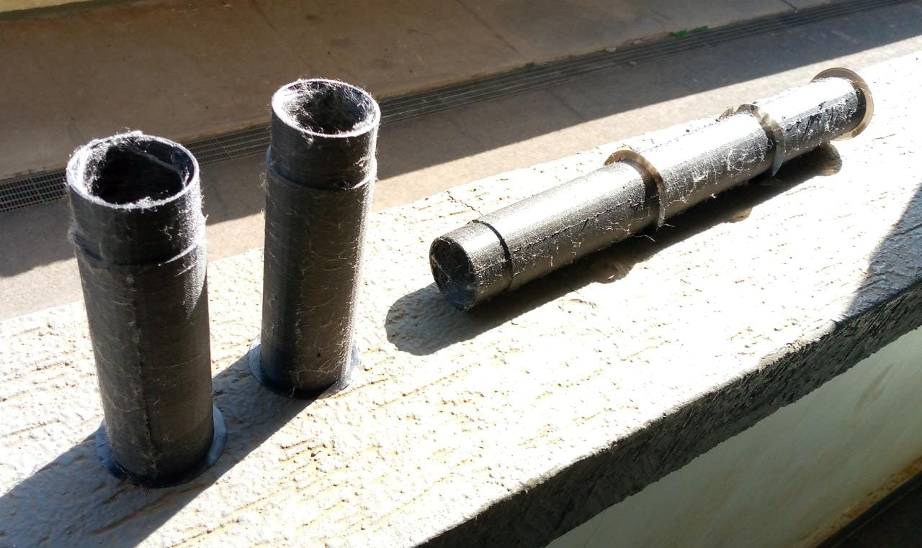
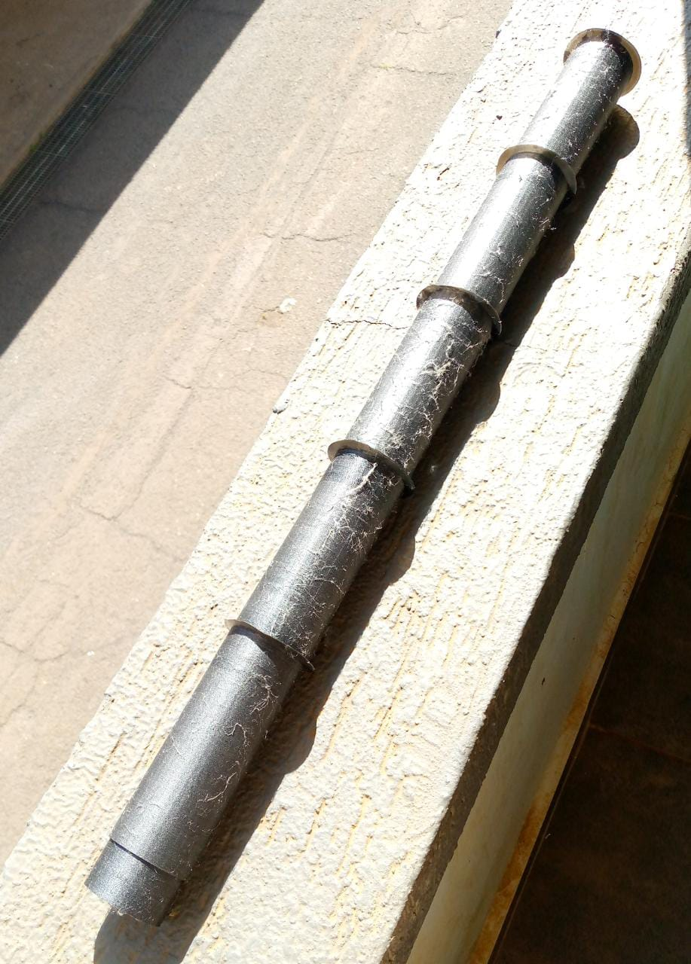
PICTORIAL OF THE DESIGNS
CAD design
3D printed body tubes
Assembled

Slide 5
CAD DESIGN
CAD designs for the rocket parts was carried out in Inventor Professional 2022
Body tubes
Nose cone
Fins
Camera holder
THESE PARTS WILL BE LATER 3D PRINTED AND THEN FABRICATED USING FIBREGLASS

Slide 6
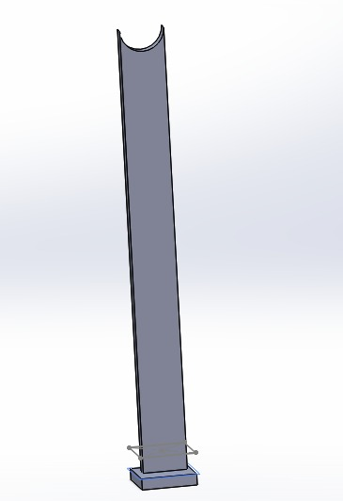
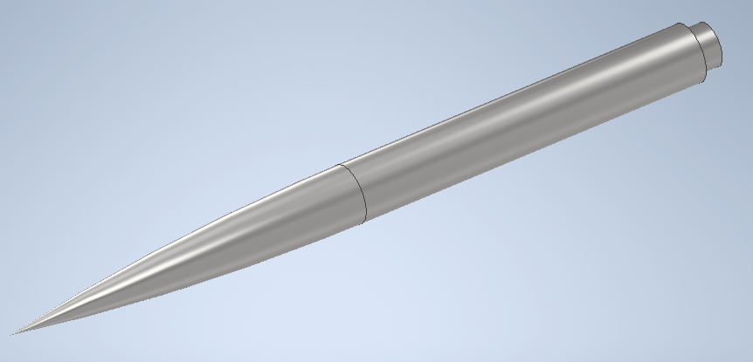
PICTORIAL OF DESIGNS
Nose cone
Cradle stand
Body tube

Slide 7
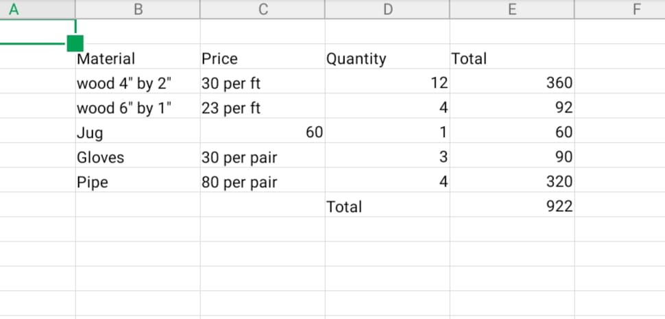
CRADLE FABRICATION (PREPARATION)
A list of purchase for materials required for cradle fabrication was made
Purchase of the materials was done.

Slide 8
Tasks completed this week
CAD Design [Github issue#59]
Purchase of materials [Github issue#60]

Slide 9
Tasks in this week
Cradle Fabrication [Github issue#58]
Body rig design{Github issue #79}
Camera mount[Github issue #81]
Tea slot[Github issue#80]
Engine Block design[Github issue#78]

Slide 10
TIME PLAN
WEEK 1-material SELECTION, ANALYSIS AND COST
WEEK 2-DESIGN AND SIMULATION.
WEEK 3-SIMULATION CORRECTIONS.
WEEK 4-RECOVERY SYSTEM.
WEEK 5-ASSEMBLY AND FABRICATION.
WEEK 6-ASSEMBLY AND FABRICATION.
WEEK 7-FINALISATION.
WEEK 8-TAKE OFF.
PRONE TO CHANGE AS PER THE SITUATION.

Slide 11
THE END
THANK YOU!

